Slide 1
REST
It is an architectural guideline to develop Web API.

Slide 2
REST API
The API which is developed using REST is known as REST API / RESTful API.

Slide 3
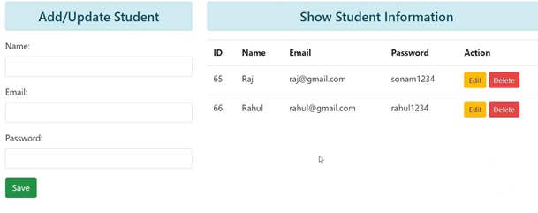
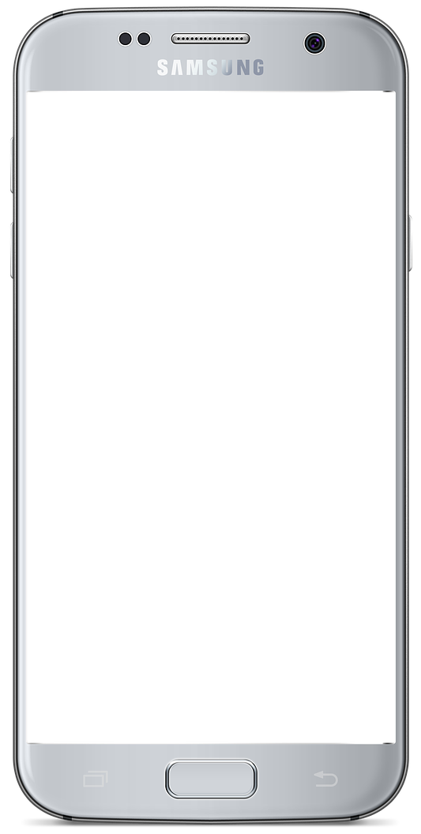

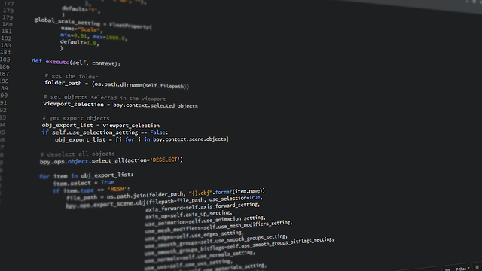
REST Web API
Web Application
Database

Slide 4
How REST Web API Works
Web API
Web Application
Database
Client makes HTTP Request to API
API will communicate to Web Application/Database (If needed)
Web Application/Database provides required data to API
API returns Response Data to Client
Note – Json Data, XML Data

Slide 5
REST API
CRUD Operations:-
Operation | HTTP Methods | Description
Create | POST | Creating/Posting/Inserting Data
Read | GET | Reading/Getting/Retrieving Data
Update | PUT, PATCH | Updating Data Complete Update - PUT Partial Update - PATCH
Delete | DELETE | Deleting Data

Slide 6
Students API Resource
http://geekyshows.com/api/students
1. Base URL
2. Naming Convention
3. Resource of API or End-Point
1
2
3

Slide 7
Request - Response
Request for All Students
Response
[
{"id":1, "name": "Rahul"},
{"id":2, "name" : "Sonam"},
….
]
Request
GET: /api/students

Slide 8
Request - Response
Request for One Student having id = 1
Response
[
{"id":1, "name": "Rahul" }
]
Request
GET: /api/students/1

Slide 9
Request - Response
Request Posting/Creating/Inserting Data
Request
POST: api/students
{"name": “Sumit"}
Response
{"id":11, "name": “Sumit”}

Slide 10
Request - Response
Request for Updating Data, id = 1
Response
[
{"id":1, "name": "Raj" }
]
Request
PUT or PATCH: /api/students/1
{"name": “Raj" }

Slide 11
Request - Response
Request for Deleting Data, id = 1
Request
DELETE: /api/students/1
Response
{"id":1, "name": "Raj" }

Slide 12
RESTful API
http://geekyshows.com/api/students
GET /api/students
GET /api/students/1
POST /api/students
PUT /api/students/1
PATCH /api/students/1
DELETE /api/students/1

